Slide 1
Code Category Management Module
Tasks List:
Code CategoryDAO + Unit Tests
Implement List Categories feature
Implement Create Category feature
Implement Edit Category feature
Implement Delete Category feature
Update Website’s Home Page

Slide 2
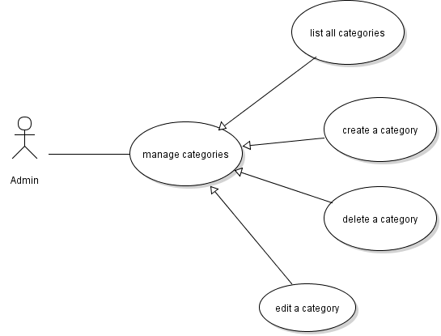
Category Management Use Case

Slide 3
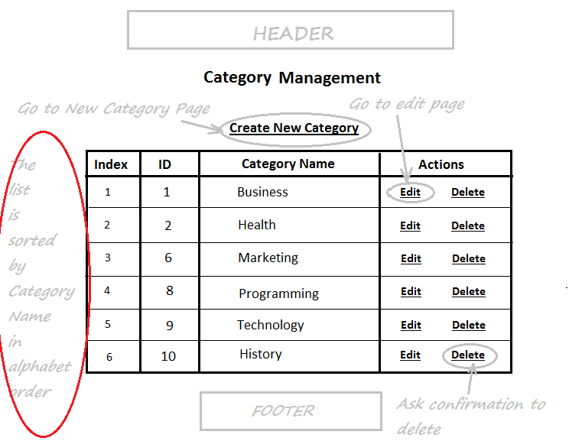
Category List Page

Slide 4
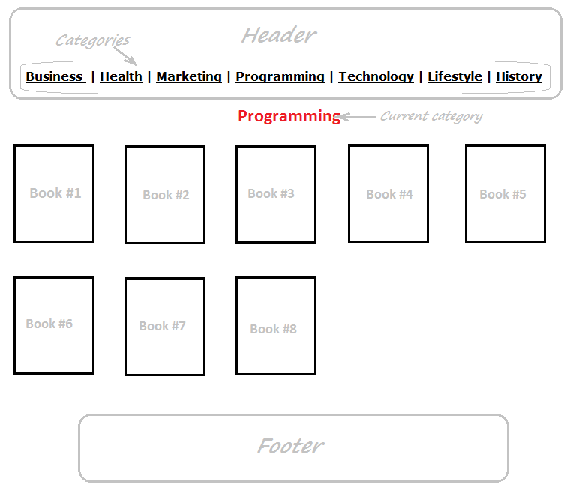
Categories in Website’s Home Page

Slide 5
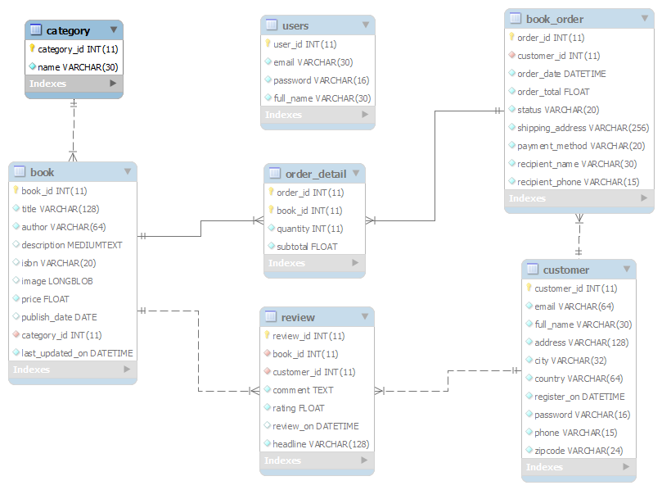
Database Design –Table Category

Slide 6
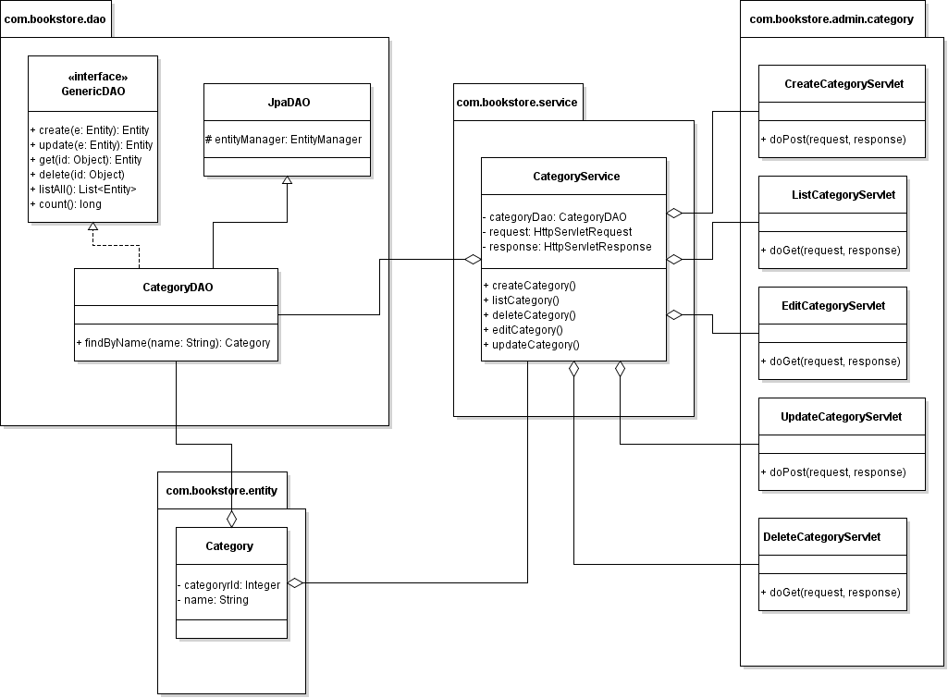
Class Diagram

Slide 7
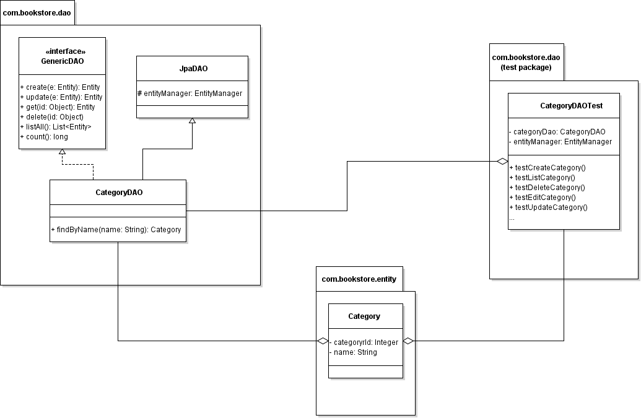
Code CategoryDAO + Unit Tests

Slide 8
Implement List Category Feature
Code ListCategoryServlet
Code CategoryServices
Code Category List Page (HTML + JSTL)

Slide 9
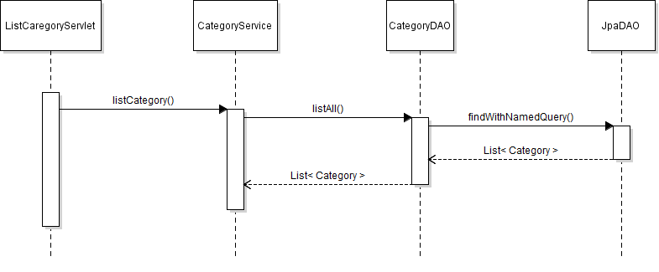
List Category Sequence Diagram

Slide 10
Category List Page

Slide 11
Implement Create Category Feature
Code Category Form Page (JSP)
Validate Form’s Input (Javascript)
Code CreateCategoryServlet Class
Update CategoryServices Class

Slide 12
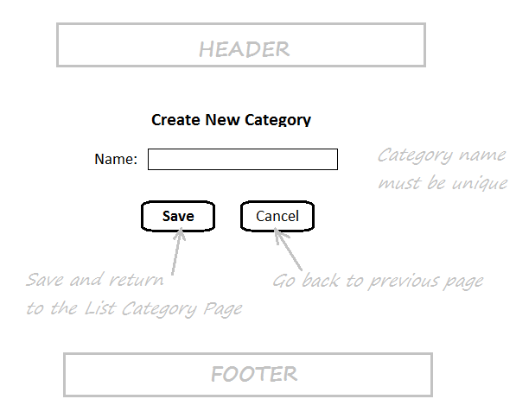
Category Form Page

Slide 13
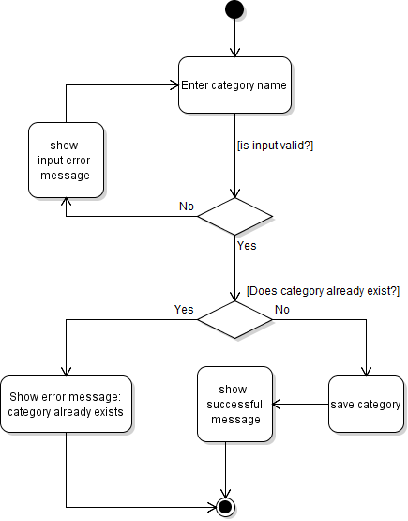
Activity Diagram: Create Category

Slide 14
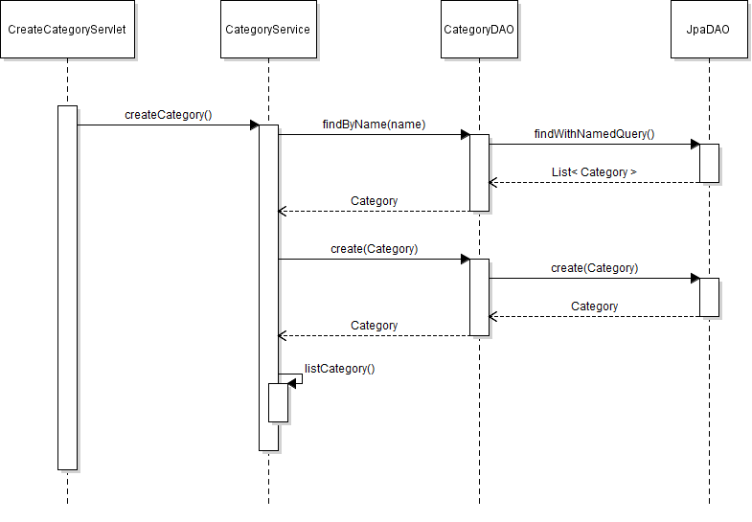
Sequence Diagram: Create Category

Slide 15
Implement Edit Category Feature
Create EditCategoryServlet Class
Update Category Form Page (JSP)
Create UpdateCategoryServlet Class
Update CategoryServices Class

Slide 16
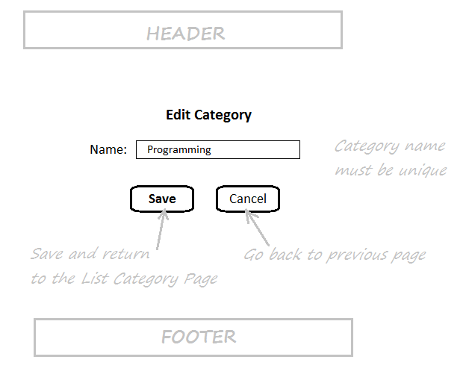
Category Form in Edit Mode

Slide 17
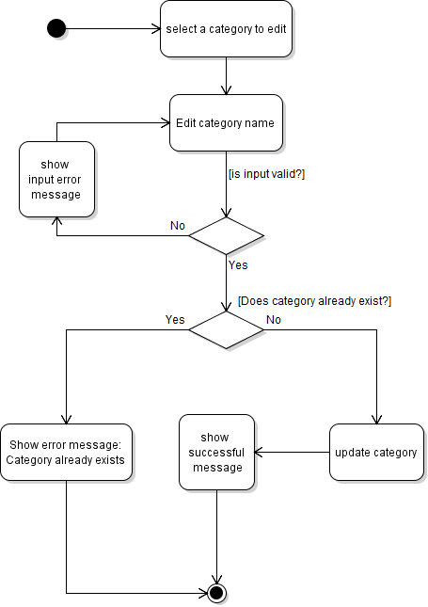
Activity Diagram: Update Category

Slide 18
Class Diagram

Slide 19
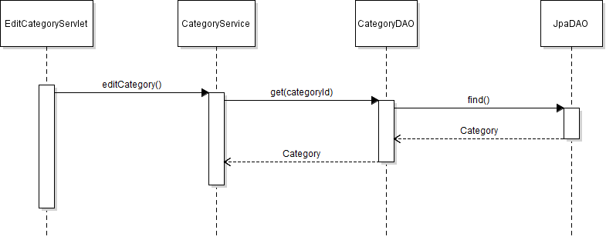
Sequence Diagram: Edit Category

Slide 20
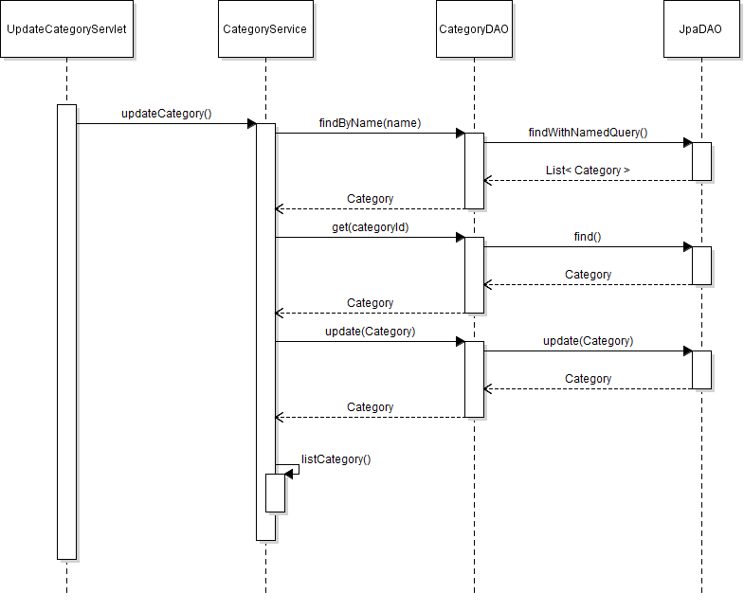
Sequence Diagarm: Update Category

Slide 21
Implement Delete Category Feature
Show Delete Confirmation Dialog
Create DeleteCategoryServlet Class
Update CategoryServices Class

Slide 22
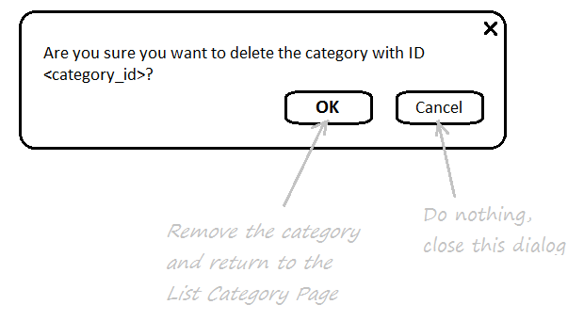
Delete Category Confirmation Dialog

Slide 23
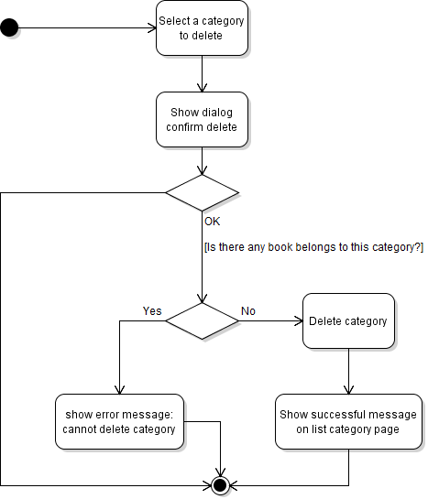
Activity Diagram: Delete Category

Slide 24
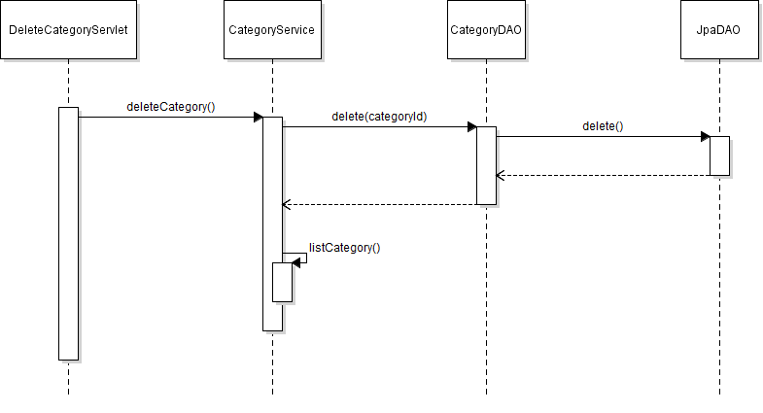
Sequence Diagram: Delete Category

